Slide 1


Indranil Chakraborty
20th July, 2022

Slide 2

Outline
Executive Summary
Introduction
Methodology
Results
Conclusion
Appendix

Slide 3
Executive Summary
Summary of methodologies
Data Collection through API
Data Collection with Web Scraping
Data Wrangling
Exploratory Data Analysis with SQL
Exploratory Data Analysis with Data Visualization
Interactive Visual Analytics with Folium and Dashboard
Predictive Analysis using Machine learning
Summary of all results
Exploratory Data Analysis result
Interactive Analytics with screenshots
Predictive Analysis result

Slide 4
Introduction
Project background and context
Space X advertises Falcon 9 rocket launches on its website with a cost of 62 million dollars; other providers cost upward of 165 million dollars each, much of the savings is because Space X can reuse the first stage. Therefore, if we can determine if the first stage will land, we can determine the cost of a launch. This information can be used if an alternate company wants to bid against space X for a rocket launch. This goal of the project is to create a machine learning pipeline to predict if the first stage will land successfully.
Problems you want to find answers
What Factors determine if the rocket will launch successfully?
The interaction among various features that determine the success rate of a successful landing
What operating conditions need to be in place to ensure a successful landing program?

Slide 5

Section 1

Slide 6
Methodology
Executive Summary
Data collection methodology:
Data was collected using SpaceX API and web scraping from Wikipedia
Perform data wrangling
One hot encoding was applied to categorical features
Perform exploratory data analysis (EDA) using visualization and SQL
Perform interactive visual analytics using Folium and Plotly Dash
Perform predictive analysis using classification models
How to build, tune, evaluate classification models

Slide 7
Data Collection
The data was collected using various methods
Data collection was done using get request to the SpaceX API.
Next, we decoded the response content as a Json using .json() function call and turn it into a pandas dataframe using .json_normalize().
We then cleaned the data, checked for missing values and fill in missing values where necessary.
In addition, we performed web scraping from Wikipedia for Falcon 9 launch records with BeautifulSoup.
The objective was to extract the launch records as HTML table, parse the table and convert it to a pandas dataframe for future analysis.

Slide 8
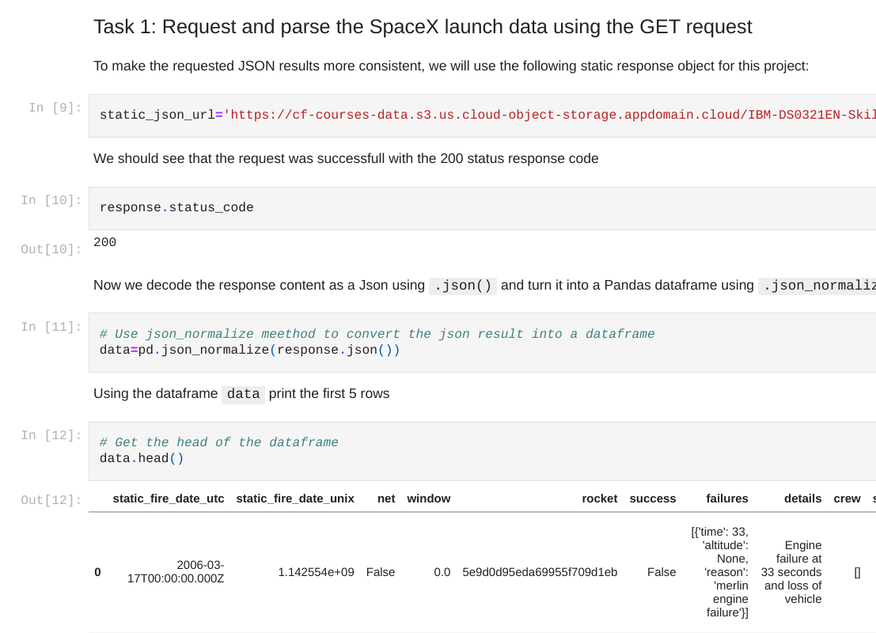
Data Collection – SpaceX API
We used the get request to the SpaceX API to collect data, clean the requested data and did some basic data wrangling and formatting.
The GitHub URL of the completed SpaceX API calls notebook is:
https://github.com/indranilch2014/Capstone-project-SpaceX/blob/main/jupyter-labs-spacex-data-collection-api11.ipynb

Slide 9
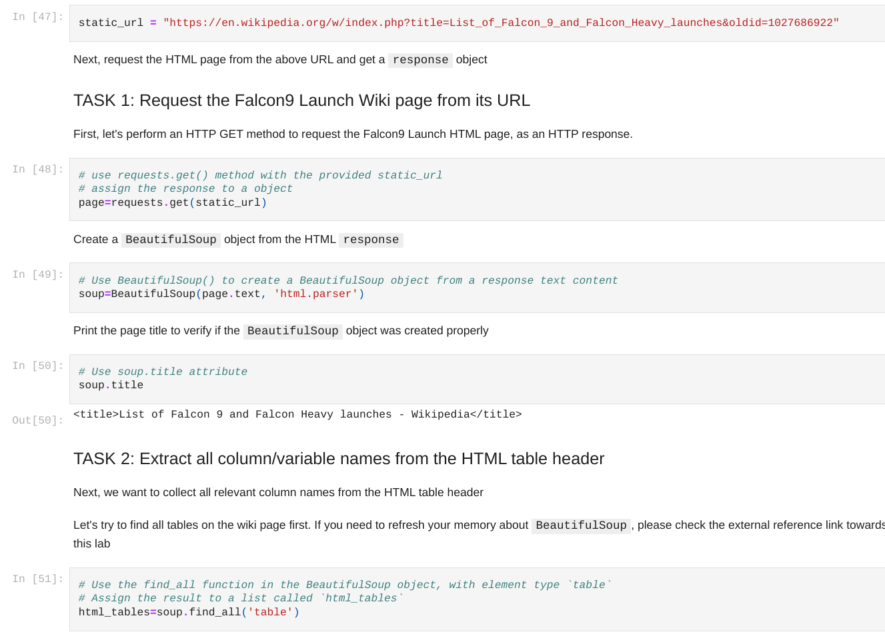
Data Collection
- Scraping
We applied web scrapping to webscrap Falcon 9 launch records with BeautifulSoup
We parsed the table and converted it into a pandas dataframe.
The GitHub URL of the completed web scraping notebook:
https://github.com/indranilch2014/Capstone-project-SpaceX/blob/main/jupyter-labs-webscraping11.ipynb

Slide 10
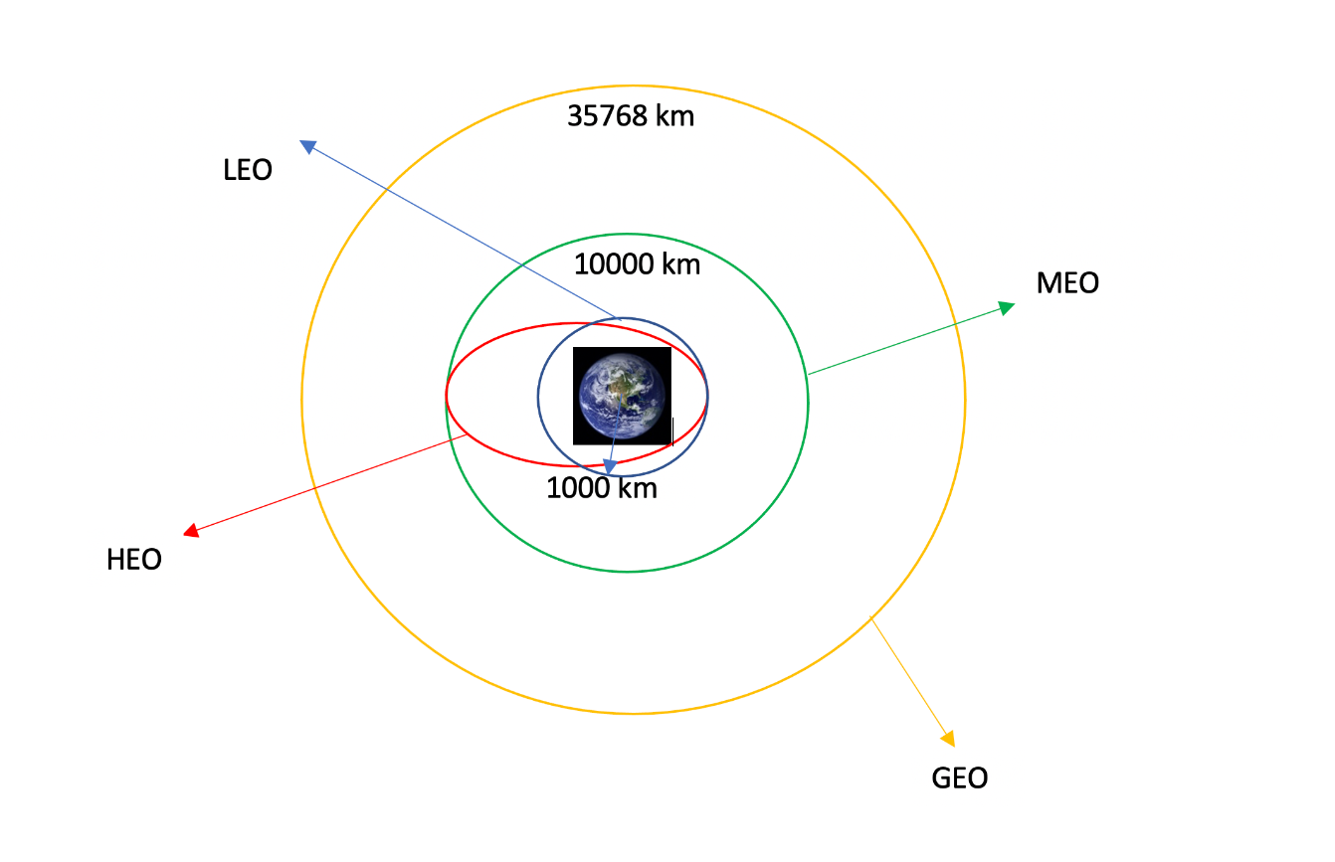
Data Wrangling
We performed exploratory data analysis and determined the training labels.
We calculated the number of launches at each site, and the number and occurrence of each orbits
We created landing outcome label from outcome column and exported the results to csv.
The GitHub URL of my completed data wrangling related notebook:
https://github.com/indranilch2014/Capstone-project-SpaceX/blob/main/labs-jupyter-spacex-Data%20wrangling11.ipynb

Slide 11
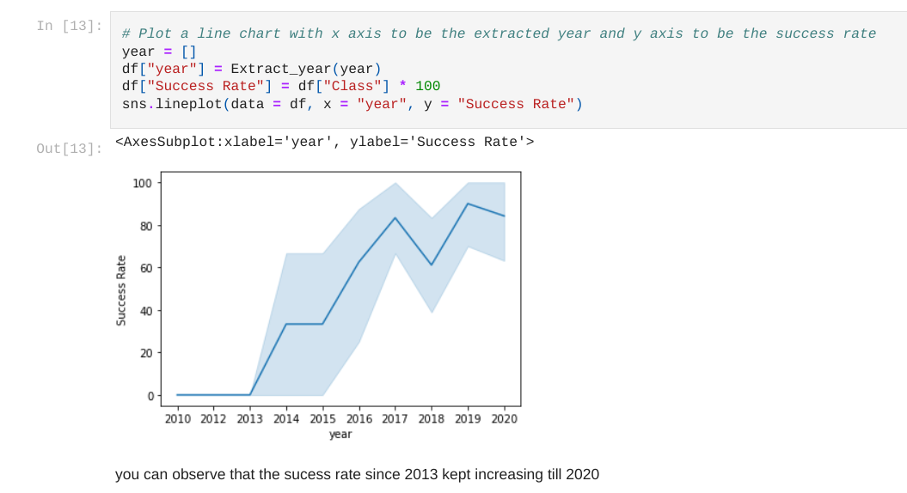
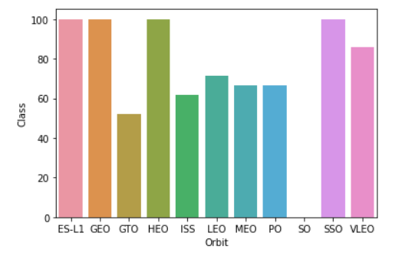
EDA with Data Visualization
We explored the data by visualizing the relationship between flight number and launch Site, payload and launch site, success rate of each orbit type, flight number and orbit type, the launch success yearly trend.
The plot below shows the success rate of each Orbit type.
The GitHub URL of my completed EDA with data visualization notebook:
https://github.com/indranilch2014/Capstone-project-SpaceX/blob/main/jupyter-labs-eda-dataviz11.ipynb

Slide 12
EDA with SQL
We loaded the SpaceX dataset into an SQL database without leaving the jupyter notebook.
We applied EDA with SQL to get insight from the data. We wrote queries to find out for instance:
The names of unique launch sites in the space mission.
The total payload mass carried by boosters launched by NASA (CRS)
The average payload mass carried by booster version F9 v1.1
The total number of successful and failure mission outcomes
The failed landing outcomes in drone ship, their booster version and launch site names.
The GitHub URL of my completed EDA with SQL notebook:
https://github.com/indranilch2014/Capstone-project-SpaceX/blob/main/jupyter-labs-eda-sql-coursera_sqllite11.ipynb

Slide 13
Build an Interactive Map with Folium
We marked all launch sites, and added map objects such as markers, circles, lines to mark the success or failure of launches for each site on the folium map.
We assigned the feature launch outcomes (failure or success) to class 0 and 1.i.e., 0 for failure, and 1 for success.
Using the color-labeled marker clusters, we identified which launch sites have relatively high success rate.
We calculated the distances between a launch site to its proximities. We answered some question for instance:
Are launch sites near railways, highways and coastlines?
Do launch sites keep certain distance away from cities?
The GitHub URL of my completed interactive map with Folium map:
https://github.com/indranilch2014/Capstone-project-SpaceX/blob/main/lab_jupyter_launch_site_location11.ipynb

Slide 14
Build a Dashboard with Plotly Dash
We built an interactive dashboard with Plotly dash
We plotted pie charts showing the total launches by a certain sites
We plotted scatter graph showing the relationship with Outcome and Payload Mass (Kg) for the different booster version.
The GitHub URL of my completed Plotly Dash lab:
https://github.com/indranilch2014/Capstone-project-SpaceX/blob/main/plotly_dash.py

Slide 15
Predictive Analysis (Classification)
We loaded the data using numpy and pandas, transformed the data, split our data into training and testing.
We built different machine learning models and tune different hyperparameters using GridSearchCV.
We used accuracy as the metric for our model, improved the model using feature engineering and algorithm tuning.
We found the best performing classification model and found the best hyperparameters.
The GitHub URL of my completed predictive analysis lab:
https://github.com/indranilch2014/Capstone-project-SpaceX/blob/main/Machine-learning-prediction.ipynb

Slide 16
Results
Exploratory data analysis results
Interactive analytics demo in screenshots
Predictive analysis results

Slide 17

Section 2

Slide 18
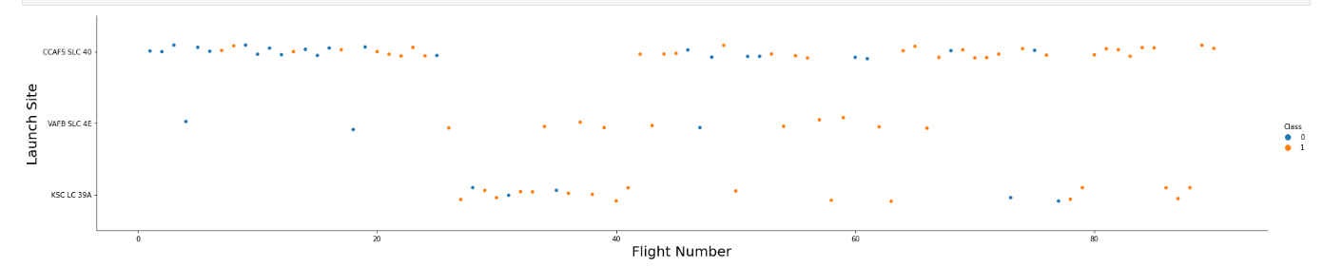
Flight Number vs. Launch Site
From the plot, we found that the larger the flight number at a launch site, the greater the success rate at a launch site.

Slide 19
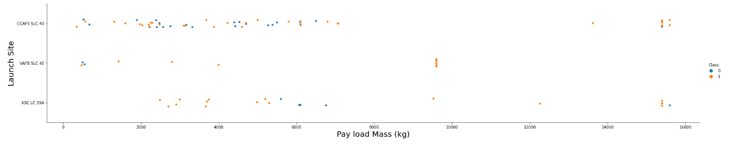
Payload vs. Launch Site
From the plot, we found that if the payload mass is lesser than 5000kg or greater than 9000kg at the launch site named KSC LC 39A, there is higher success rate and for the launch site CCAFS SLC 40, there is higher success rate for payload mass above 13000kg

Slide 20

Success Rate vs. Orbit Type
From the plot, we can see that ES-L1, GEO, HEO, SSO orbit types had the most success rate.
The VLEO orbit type had the second highest success rate.
The GTO orbit type had the lowest success rate.

Slide 21
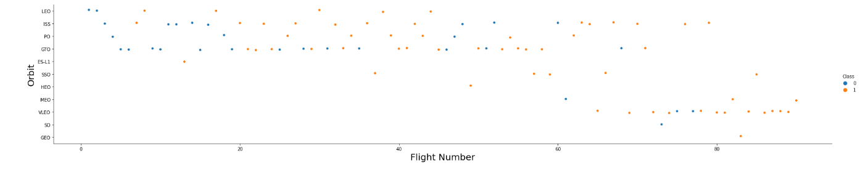
Flight Number vs. Orbit Type
The plot below shows the Flight Number vs. Orbit type. We observe that in the LEO orbit, success is related to the number of flights whereas in the GTO orbit, there is no relationship between flight number and the orbit.

Slide 22
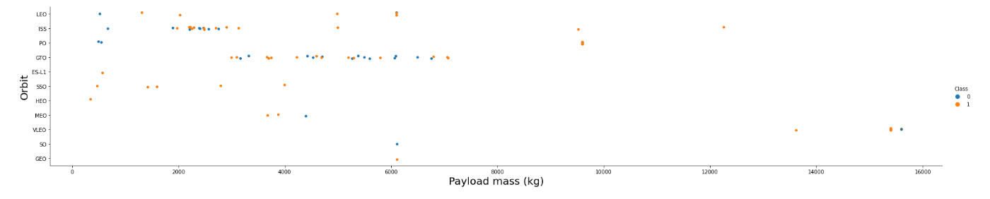
Payload vs. Orbit Type
With heavy payloads the successful landing or positive landing rate are more for Polar, LEO and ISS orbit types.
However for GTO we cannot distinguish this well as both positive landing rate and negative landing(unsuccessful mission) are both there here.

Slide 23
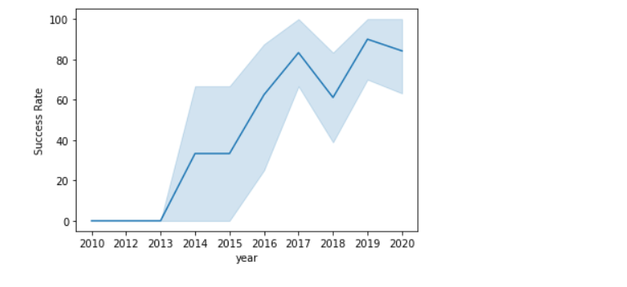
Launch Success Yearly Trend
From the plot, we can observe that success rate since 2013 kept on increasing till 2020.

Slide 24
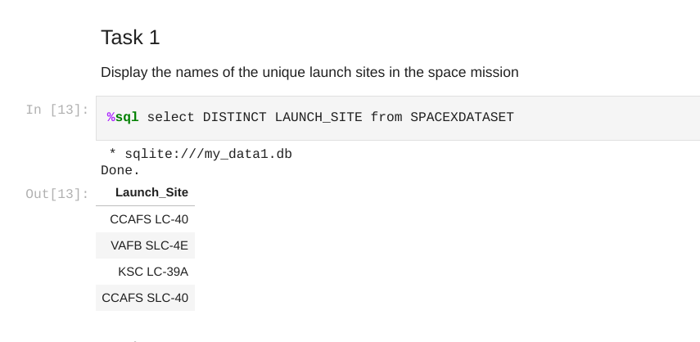
All Launch Site Names
We used the key word DISTINCT to show only unique launch sites from the SpaceX data.

Slide 25
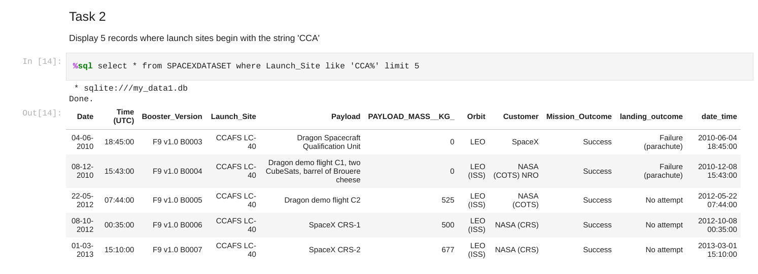
Launch Site Names Begin with 'CCA'
We used the query above to display 5 records where launch sites begin with `CCA`

Slide 26
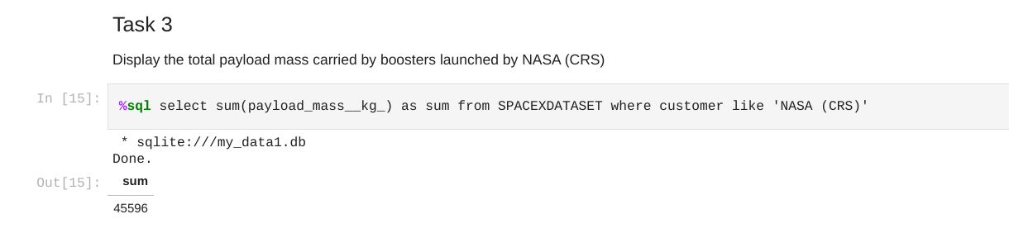
Total Payload Mass
We calculated the total payload carried by boosters from NASA as 45596 using the query below

Slide 27
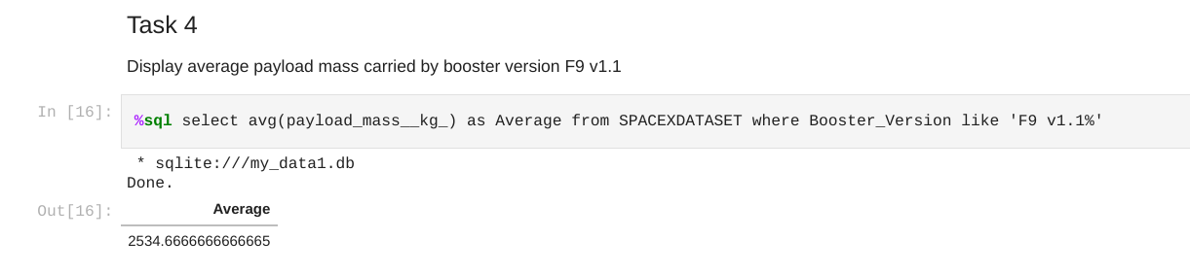
Average Payload Mass by F9 v1.1
We calculated the average payload mass carried by booster version F9 v1.1 as 2534.67 Kg approx.

Slide 28
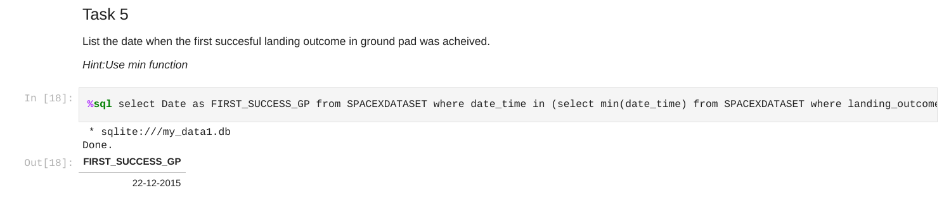
First Successful Ground Landing Date
We observed that the dates of the first successful landing outcome on ground pad was 22nd December 2015
We used the command on the jupyter notebook:
%sql select Date as FIRST_SUCCESS_GP from SPACEXDATASET where date_time in (select min(date_time) from SPACEXDATASET where landing_outcome like 'Success (ground pad)')

Slide 29
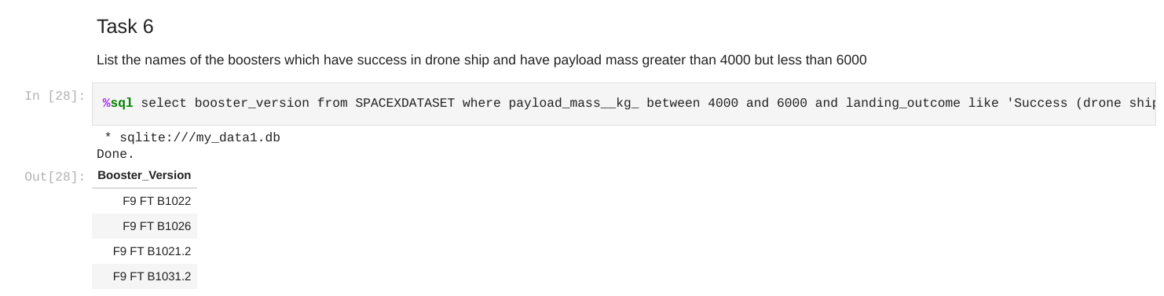
Successful Drone Ship Landing with Payload between 4000 and 6000
We used the WHERE clause to filter for boosters which have successfully landed on drone ship and applied the AND condition to determine successful landing with payload mass greater than 4000 but less than 6000

Slide 30
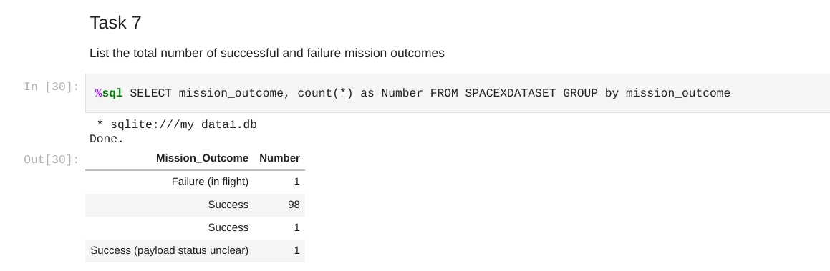
Total Number of Successful and Failure Mission Outcomes
We used count(*) and the GROUP BY clause to find the total number of failure and successful mission outcomes. We can see below that there were 100 successful outcomes and 1 failure outcome.

Slide 31
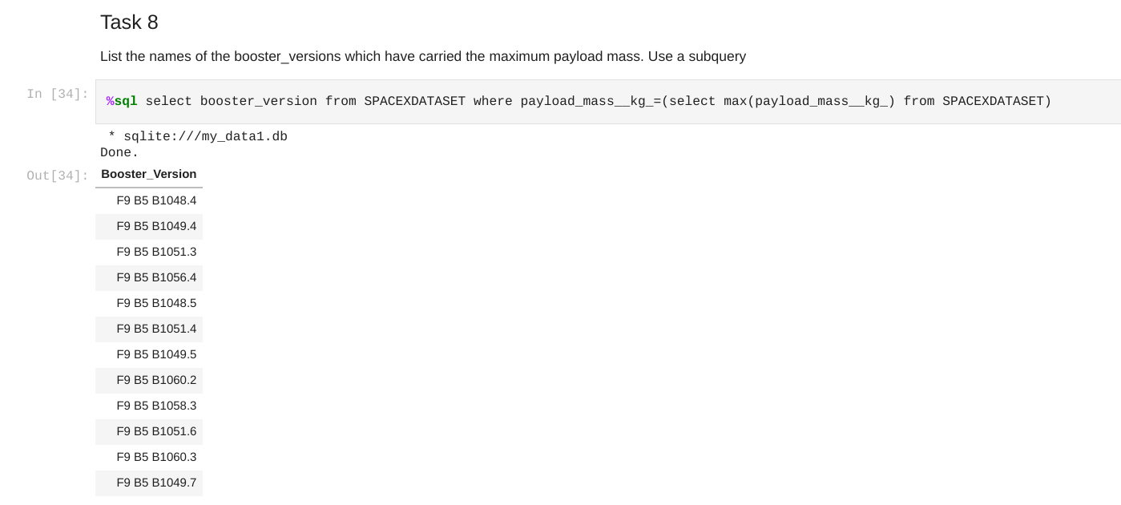
Boosters Carried Maximum Payload
We determined the booster that have carried the maximum payload using a subquery in the WHERE clause and the MAX() function.

Slide 32
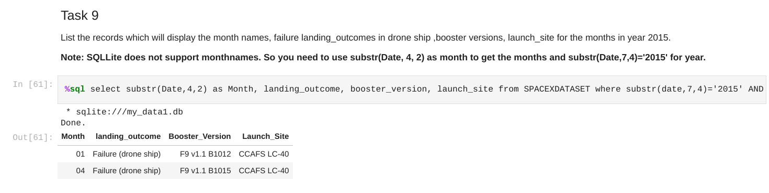
2015 Launch Records
We used a combinations of the WHERE clause, LIKE, AND, and BETWEEN conditions to filter for failed landing outcomes in drone ship, their booster versions, and launch site names for year 2015 and also used the SUBSTR() function to obtain the month and year from the date column

Slide 33
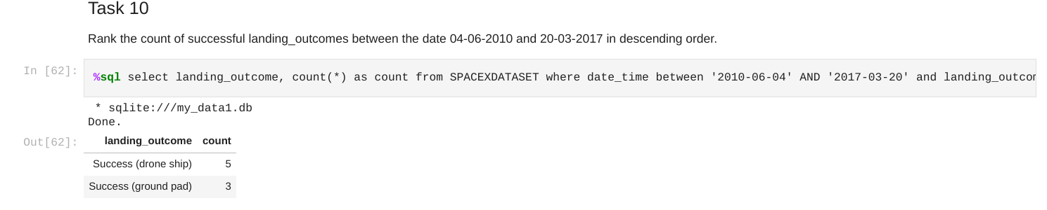
Rank Landing Outcomes Between 2010-06-04 and 2017-03-20
The following command was used :
%sql select landing_outcome, count(*) as count from SPACEXDATASET where date_time between '2010-06-04' AND '2017-03-20' and landing_outcome like 'Success%' GROUP by landing_outcome ORDER BY count Desc
We selected Landing outcomes and the COUNT of landing outcomes from the data and used the WHERE clause to filter for landing outcomes BETWEEN 2010-06-04 to 2010-03-20.
We applied the GROUP BY clause to group the landing outcomes and the ORDER BY clause to order the grouped landing outcome in descending order.

Slide 34

Section 3

Slide 35
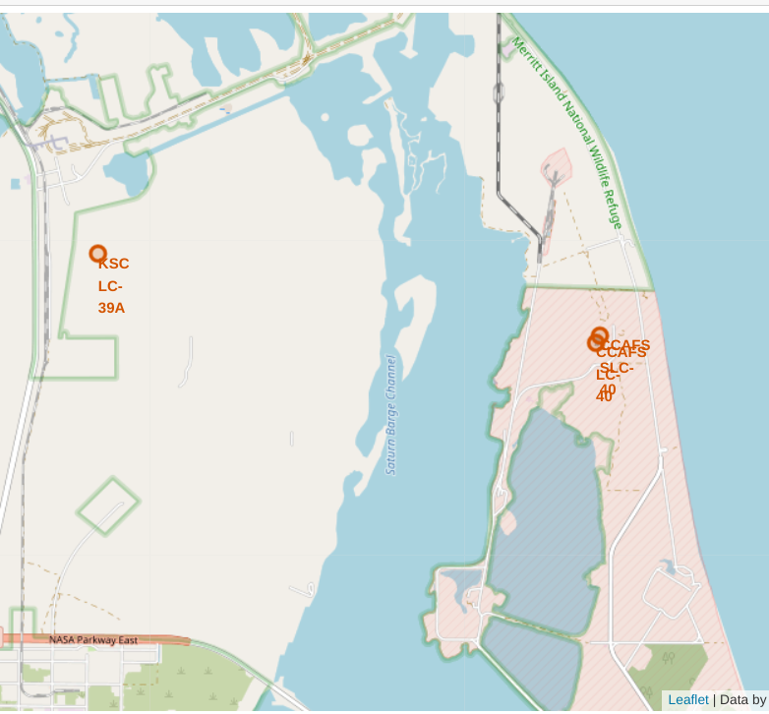
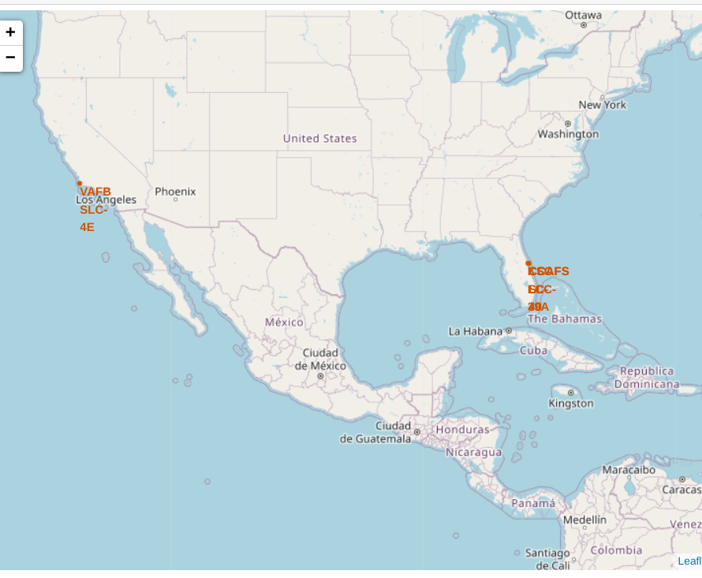
All Launch Sites' location markers
We can see that the Launch sites of SpaceX are located in the USA coastal states of Florida and California

Slide 36
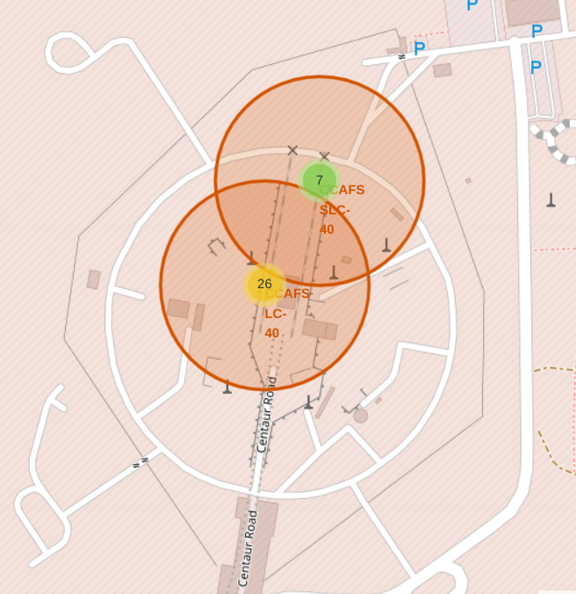
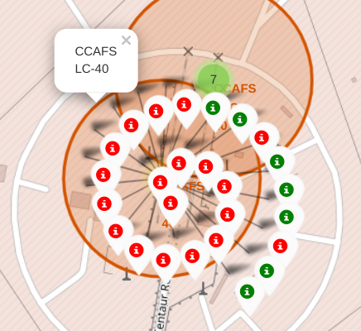
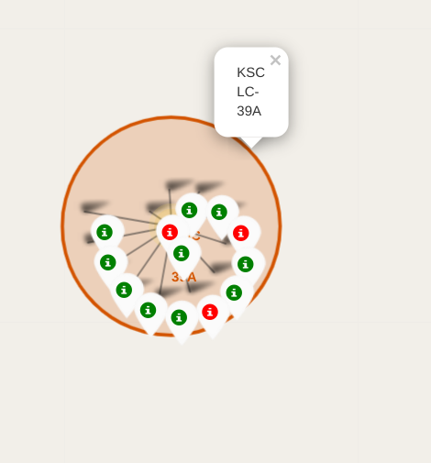
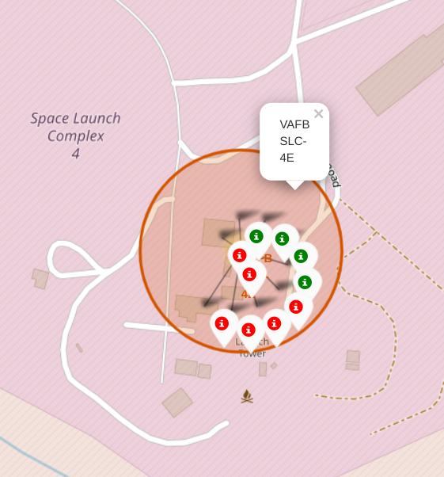
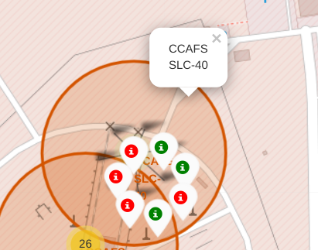
Markers showing launch sites
with color labels
Florida launch sites
California launch sites
Green markers show successful launches and Red markers show failures

Slide 37
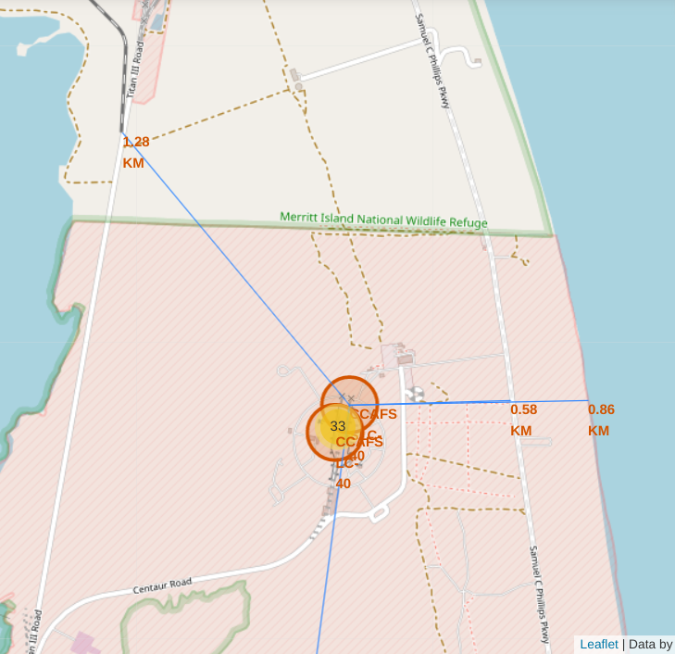
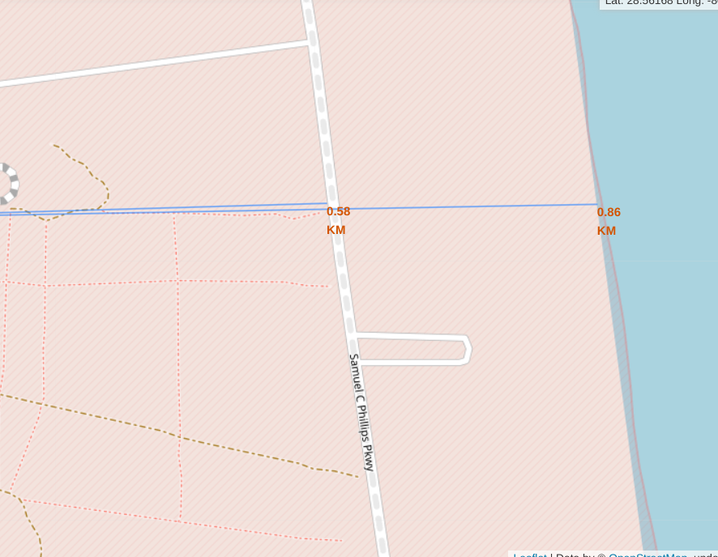
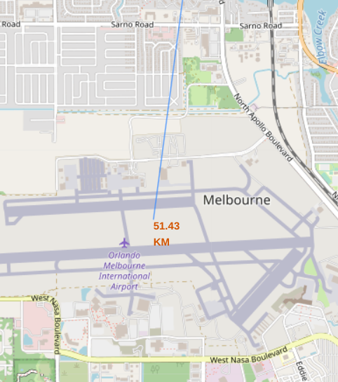
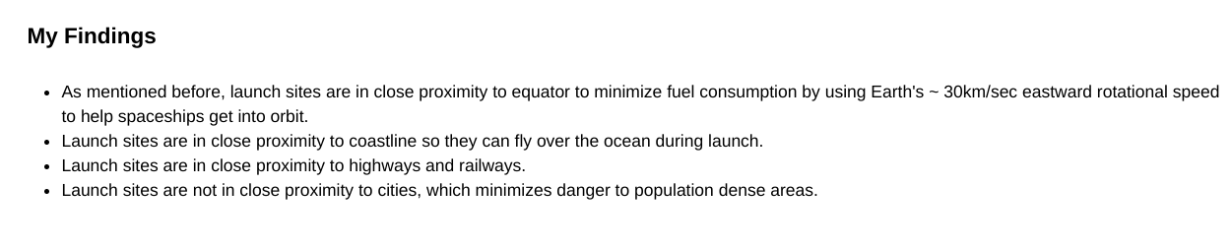
Launch site CCAFS SLC-40 and its proximities such as railway, highway, coastline, with distance are calculated and displayed
Distance from closest railway: 1.28 Km
Distance from closest coastline: 0.86 Km
Distance from closest city: 51.43 Km
Distance from closest highway: 0.56 Km

Slide 38

Section 4

Slide 39
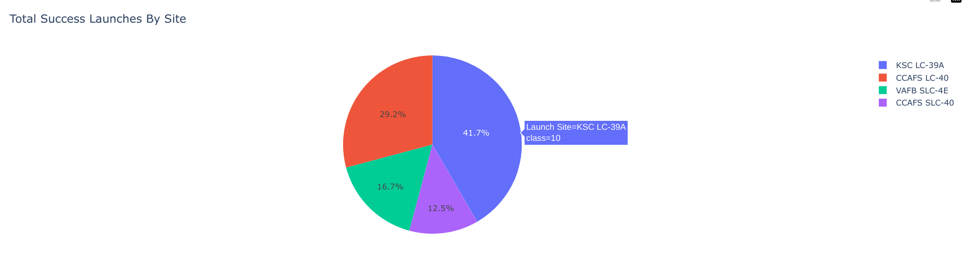
Pie chart showing the success percentage achieved by each launch site
From the pie chart shown above we can see that the launch site KSC LC-39A had the most successful launches among all the launch sites

Slide 40
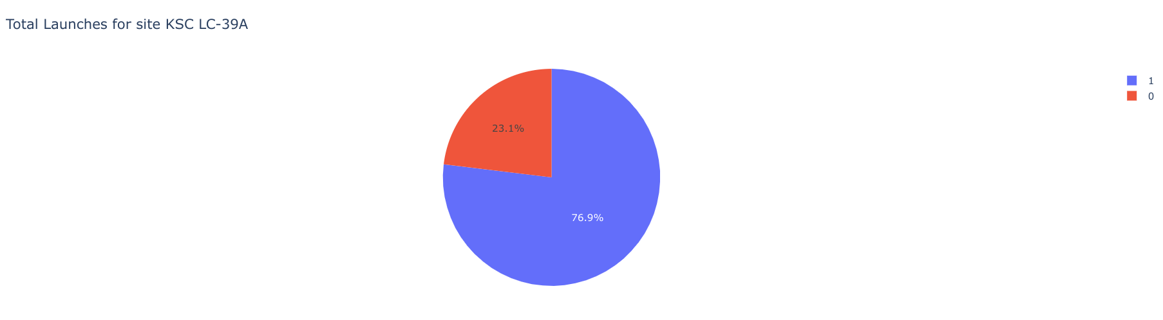
Pie chart showing the Launch site with the highest launch success ratio
From the above pie chart we can see that the launch site KSC LC-39A has a success rate of 76.9% and a failure rate of 23.1%

Slide 41
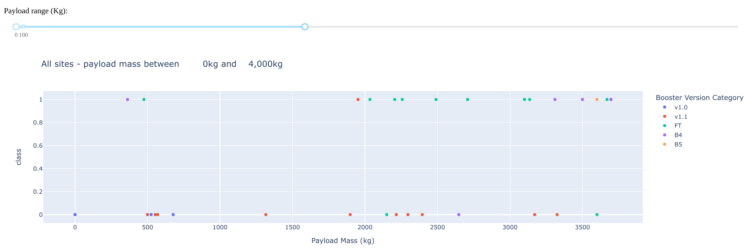
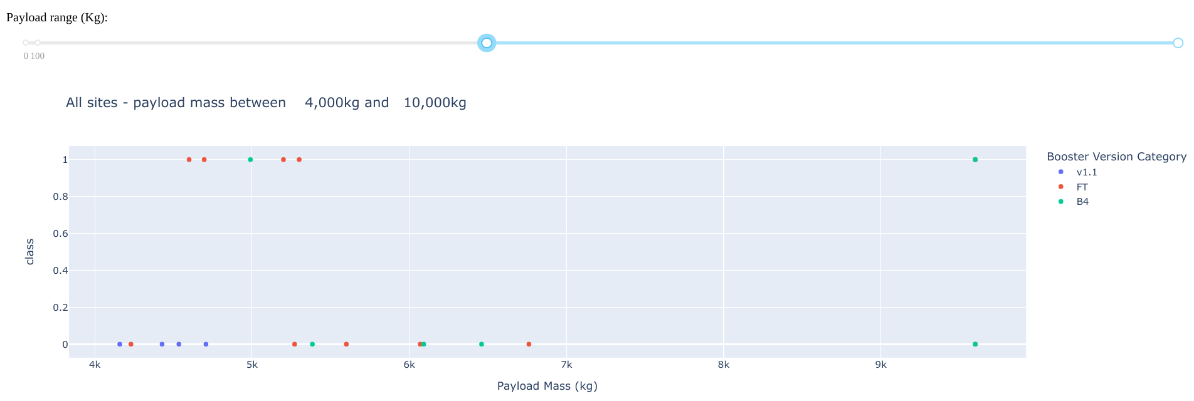
Scatter plots of Payload vs Launch Outcome for all sites, with different payload selected in the range slider
Low weighted payload: 0kg - 4000kg
We can see that the success rates for low weighted payloads is higher than the heavy weighted payloads
Heavy weighted payload: 4000kg - 10000kg

Slide 42

Section 5

Slide 43
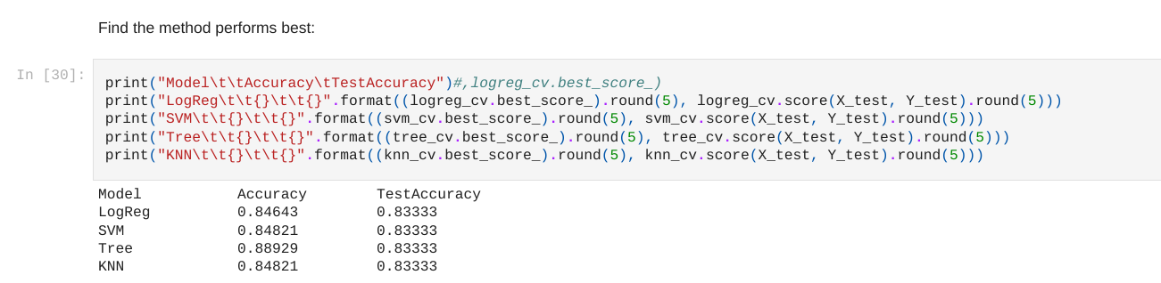
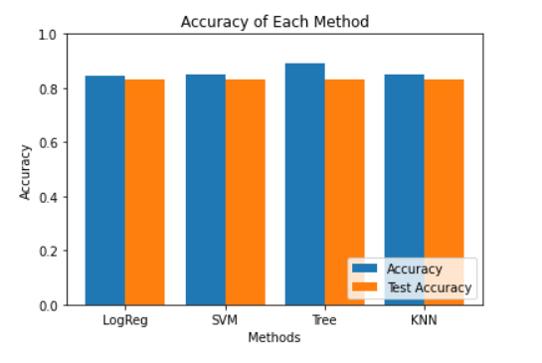
Classification Accuracy
We can see that the decision tree classifier is the classification model with the highest classification accuracy

Slide 44
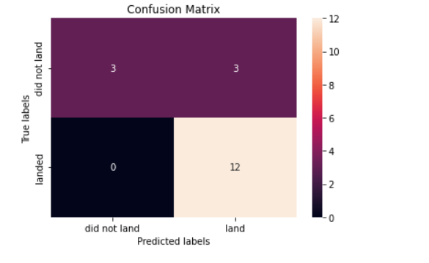
Confusion Matrix
The confusion matrix for the decision tree classifier shows that the classifier can distinguish between the different classes.
The major problem is the false positives .i.e., unsuccessful landing marked as successful landing by the classifier.

Slide 45
Conclusions
We can conclude that:
The larger the flight amount at a launch site, the greater the success rate at a launch site.
Launch success rate started to increase in 2013 till 2020.
Orbits ES-L1, GEO, HEO, SSO, VLEO had the most success rate.
KSC LC-39A had the most successful launches of any sites.
The Decision tree classifier is the best machine learning algorithm for predictive analysis (classification).

Slide 46
Acknowledgements
GitHub repository URL:
https://github.com/indranilch2014/Capstone-project-SpaceX
Instructors:
Rav Ahuja, Alex Aklson, Aije Egwaikhide, Lakshmi Holla, Svetlana Levitan, Romeo Kienzler, Polong Lin, Joseph Santarcangelo,
Nayef Abo Tayoun, Azim Hirjani, Hima Vasudevan,Saishruthi Swaminathan,
Saeed Aghabozorgi, Yan Luo
Special thanks to the instructors:
https://www.coursera.org/professional-certificates/ibm-data-science?#instructors

Slide 47
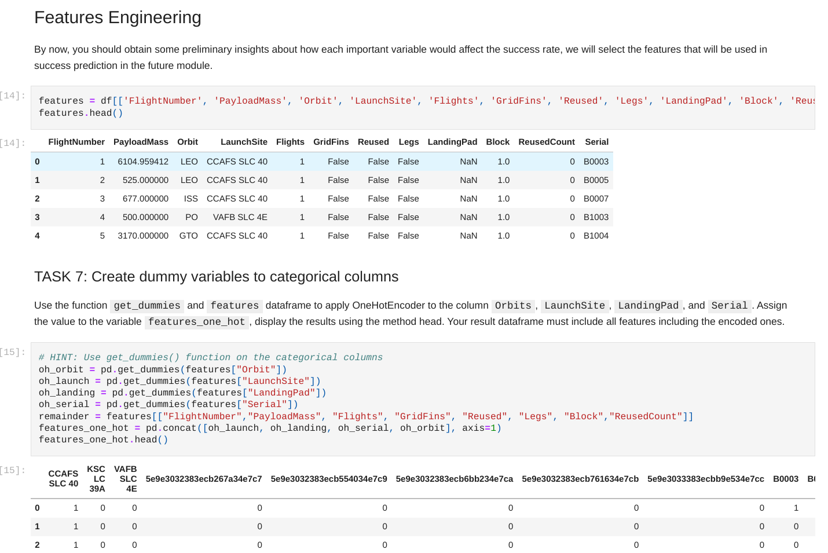
Appendix-1
The 'features' dataframe is
formed which uses various features from the SpaceX dataset to predict the success through various classification algorithms like
K-nearest neighbor,
Decision tree classifier, etc.

Slide 48
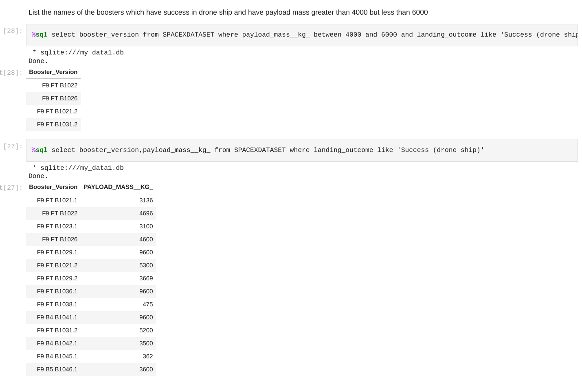
Appendix-2
We can see that we have
obtained a list of the names of all the booster versions and their corresponding payload mass in kg where there is success in drone ship and in this way we can verify if the output of the previous SQL query is correct or not

Slide 49
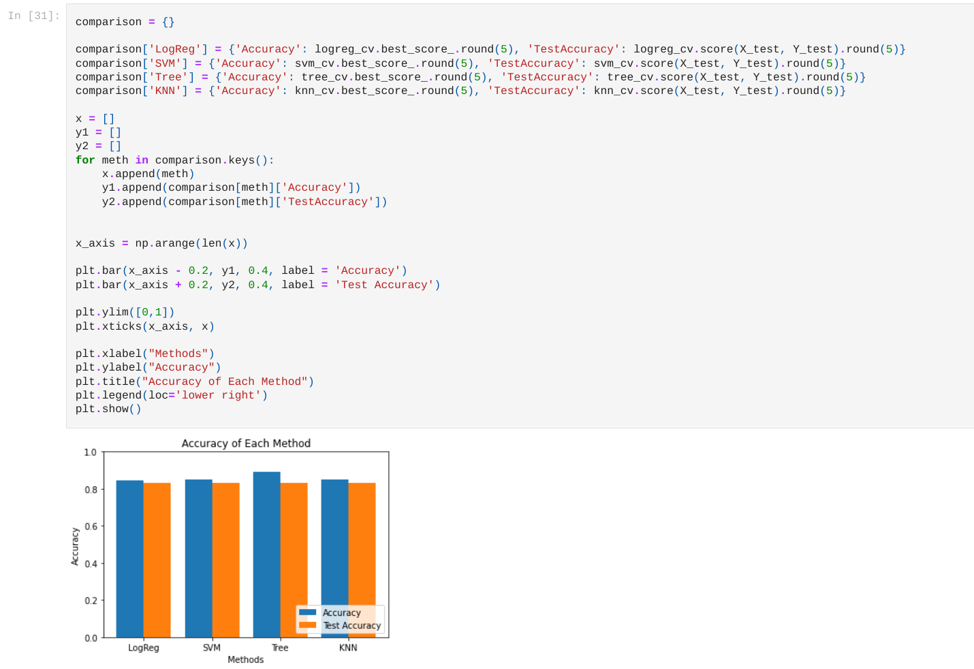
Appendix-3​
The Python code that was used to plot a Bar graph showing the accuracy on the training data and accuracy on the test data for various machine learning classification algorithms.
We can see that for all the four types of classifiers, the accuracy on the test data is the same that is 83.33%,
but on the training data, the Logistic Regression, Support Vector machine and KNN classifiers have same accuracy about 84.8% and Decision Tree has the highest accuracy which is 88.9%

Slide 50
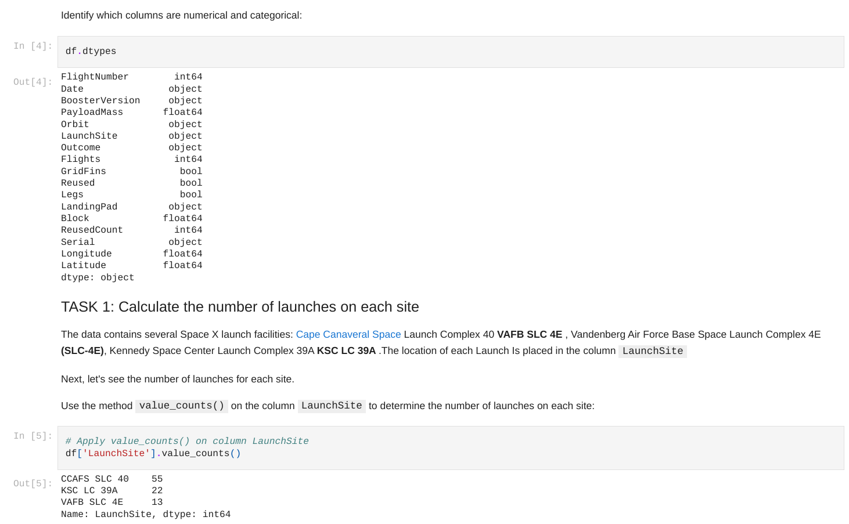
Appendix-4​​
We have obtained the column names and datatypes of the columns in the SpaceX dataset
And we have also used the value_counts() method on the pandas dataframe to determine the total number of launches from each Launch site

Slide 51


